Slide 1

WAY TO ENTERPRISE
AWS
VTI ACADEMY
Author: duy.nguyenngoc1@vti.com.vn

Slide 2
Agenda
Glue Service
Athena Service
QuickSight Service
Neptune Service
Elastic MapReduce Service
Lakehouse Architecture
Copyright © VTI Academy All Rights Reserved

Slide 3
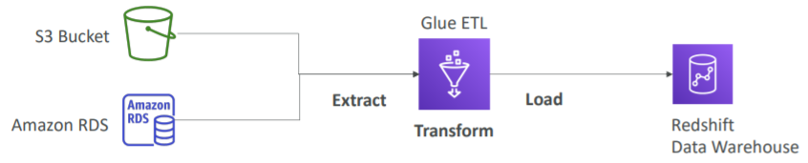
Glue Service
Managed extract, transform, load (ETL) service
Usecases: Prepare and transform data for analytics
Serverless service
Regional service
Price: https://aws.amazon.com/glue/pricing
Tutorial: https://docs.aws.amazon.com/glue/latest/dg/what-is-glue.html

Slide 4
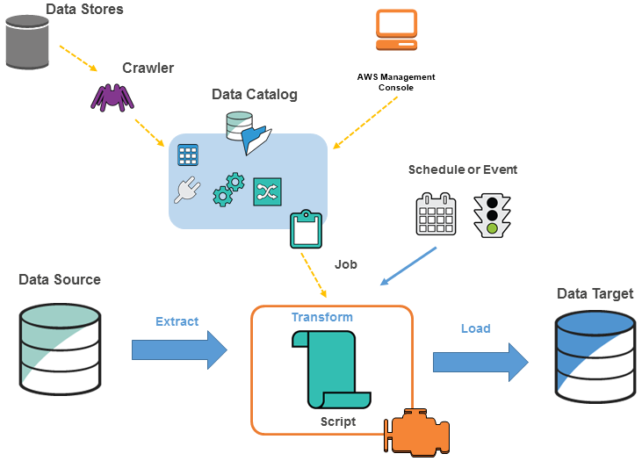
Glue Service
Data Sources: S3, RDS, DynamoDB, Redshift
Target Sources: S3, RDS, DynamoDB, Redshift

Slide 5
Glue Service
Tutorial & Demo
  https://www.youtube.com/watch?v=taR2hRZ2AwI
  https://www.youtube.com/watch?v=KkN8lQ-jr58

Slide 6
Assignment
  Self-practice

Slide 7
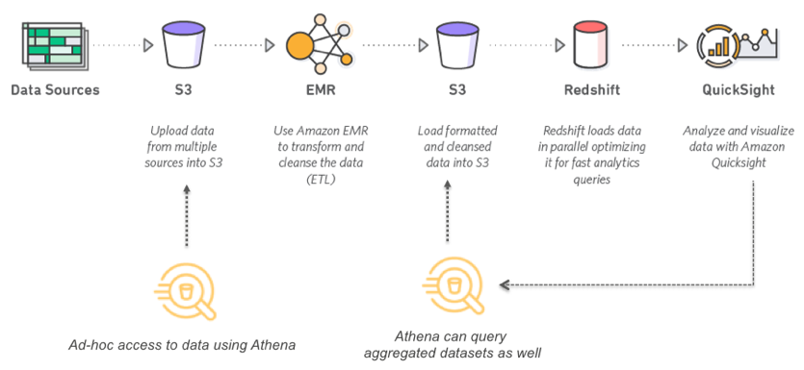
Athena Service
A service that allows querying data directly on different data sources
Ex: S3, Craw data via Glue Service (S3, RDS, DynamoDB, Redshift, ...)
Using SQL syntax
Serverless service
Run read-only query in parallel
Support compressed or columnar data
Supports CSV, JSON, ORC, Avro, Parquet (built on Presto)
Advantages over S3-Select, can create tables, create complex queries

Slide 8
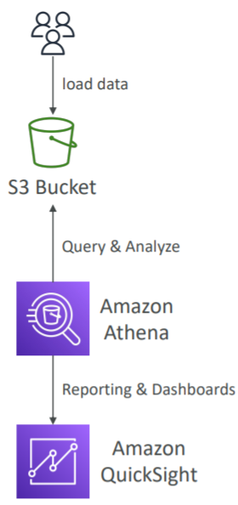
Athena Service
Usecases
  Serverless queries log files stored on S3, log analytics 🡺 generate report
  Analyze & reporting & query VPC Flow Logs, ELB Logs, CloudTrail trails, ...
Regional service
Price: https://aws.amazon.com/athena/pricing
Exam Tip: analyze data in S3 using serverless SQL 🡺 using Athena
Tutorial: https://docs.aws.amazon.com/athena/latest/ug/what-is.html

Slide 9
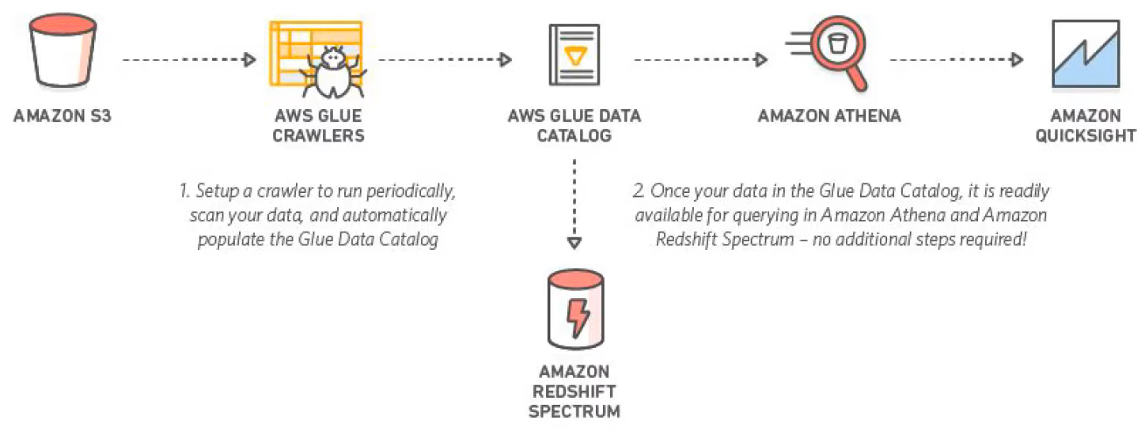
Athena Service
Athena organize data by Database, Table, View, Column (Not support function, store procedure)
Demo
  S3 bucket: Link
  S3 + Glue + Athena: Link1, Link2
S3 + Glue + Athena

Slide 10
Assignment
  Self-practice

Slide 11
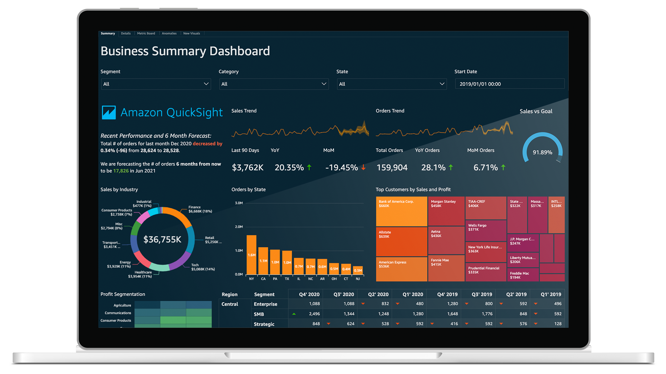
QuickSight Service
A service that allows visualize data from many different sources in a single data dashboard
Serverless service
Usecases: visualize & sight data
Tutorial: https://docs.aws.amazon.com/quicksight/latest/user/welcome.html

Slide 12
QuickSight Service
Features
  Build dashboard
  Auto Scaling up to millions of dashboard views weekly for customers
  Share data visualization with every user in the organization, whether on the web, mobile, email, embedded applications
  Integrated Machine Learning: anomaly Detection, forecast business metrics, ...
  Private VPC connectivity for secure AWS access to AWS data sources (Amazon Redshift, RDS, S3, DynamoDB,...)

Slide 13
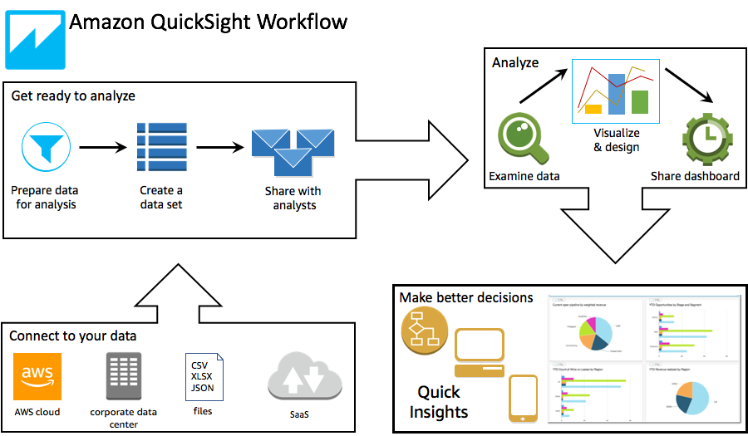
Athena Service
Flow

Slide 14
Athena Service
Demo
  https://www.youtube.com/watch?v=hh6ItJbCUQ0
  Part 1, Part 2, Part 3

Slide 15
Assignment
  Self-practice

Slide 16
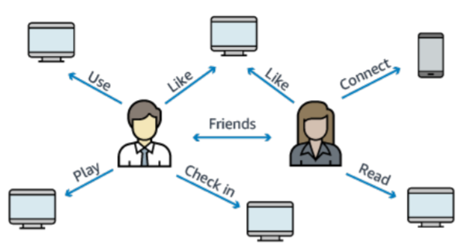
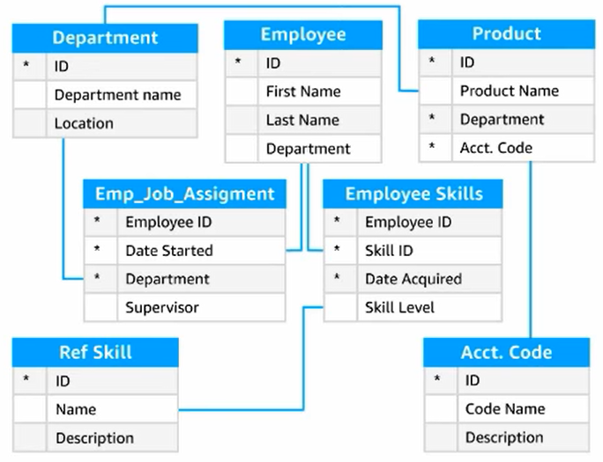
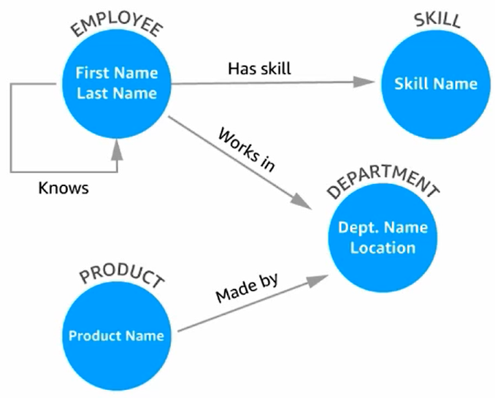
Neptune Service
Fully managed graph database
Regional service
Price: https://aws.amazon.com/neptune/pricing/
Relational Database
Graph Database
Tutorial: https://docs.aws.amazon.com/neptune/latest/userguide/intro.html

Slide 17
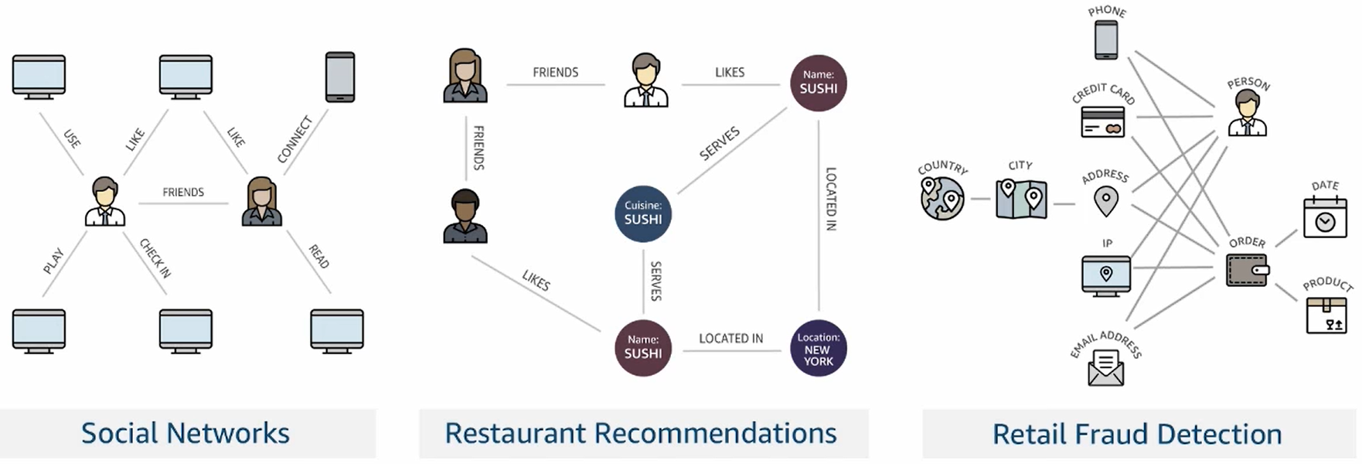
Neptune Service
Usecases
  High relationship data
  Social Networking: Users friends with Users, replied to comment on post of user and likes other comments.
  Knowledge graphs (Wikipedia)

Slide 18
Neptune Service
Tutorial: https://www.youtube.com/watch?v=rsAKj7sMbbQ

Slide 19
Assignment
  Self-practice

Slide 20
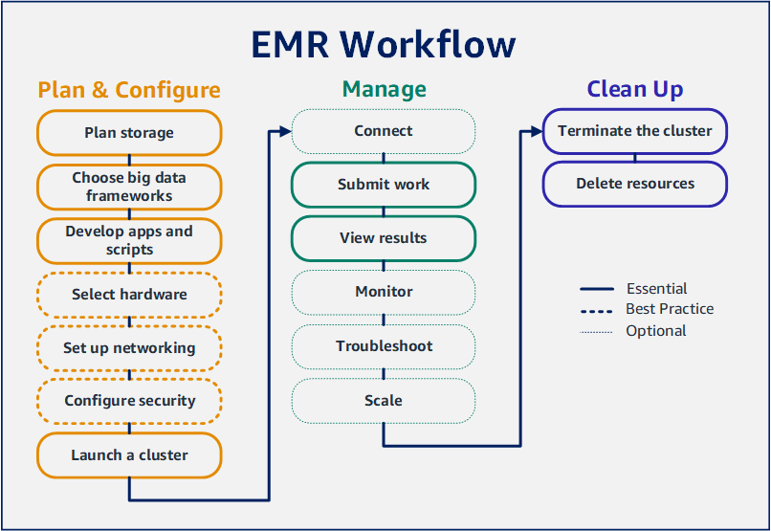
Elastic MapReduce Service
EMR stands for Elastic MapReduce
Using for running big data framework (Ex: Apache Hadoop, Apache Spark)
Helps creating clusters to analyze and process vast amount of data, the clusters can be made of hundreds of EC2 instances
Tutorial: https://docs.aws.amazon.com/emr/latest/ManagementGuide/emr-what-is-emr.html

Slide 21
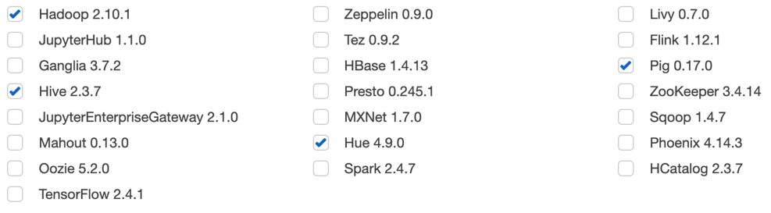
Elastic MapReduce Service
Support frameworks: Hadoop, Hbase, Presto, Spark

Slide 22
Elastic MapReduce Service
Usecases
  Data Processing: Analyze and process large amounts of data
  Move a large amount of data into/out the data store (Database, S3, DynamoDB, ...)
  Machine Learning, Big data…
  Web indexing
Regional service
Price: https://aws.amazon.com/emr/pricing

Slide 23
Elastic MapReduce Service
Tutorial
  https://www.youtube.com/watch?v=ulQdA6MUnTk
  https://docs.aws.amazon.com/emr/latest/ManagementGuide/emr-gs.html

Slide 24
Assignment
  Self-practice

Slide 25
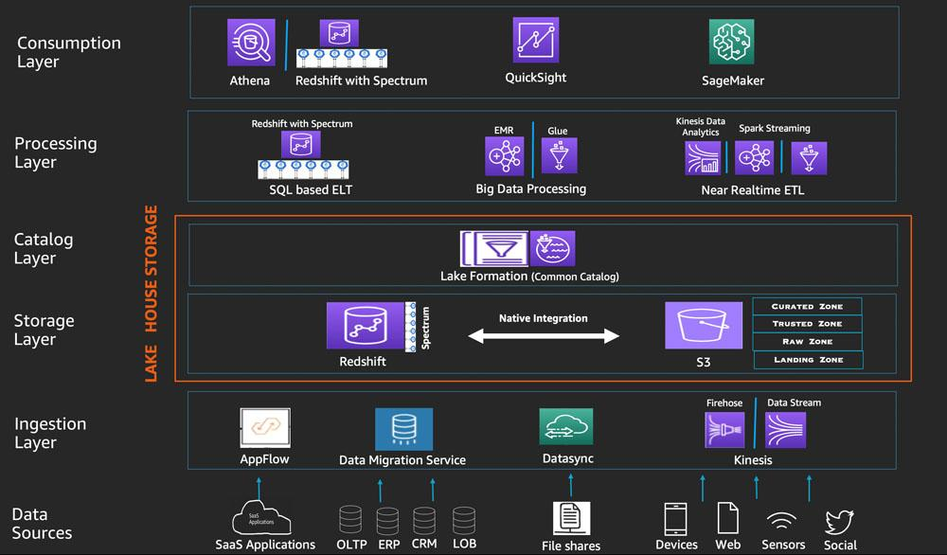
Lakehouse Architecture
Tutorial: https://aws.amazon.com/blogs/big-data/build-a-lake-house-architecture-on-aws/

Slide 26
Q & A
Copyright © VTI Academy All Rights Reserved

